Slide 1
Chapter 19
How to backup and restore a database

Slide 2
Objectives
Applied
Back up a database so it can be restored to any point in time.
Restore a database to any point in time.
Export any data that’s stored in a database to a file.
Import data from a file into a database.
Knowledge
Distinguish between a full backup and an incremental backup.
Describe the structure of a CSV file.

Slide 3
A strategy for backing up databases
Use Workbench to create full backups of each database. These backups should be stored in one or more SQL script files.
Enable the binary log as described in chapter 17 to create incremental backups.
A strategy for restoring databases
Use Workbench to restore the database from the last full backup.
Use the mysqlbinlog program to execute all statements in the binary log that occurred after the last full backup.

Slide 4
Terms to know
Full backup
Incremental backup
Point-in-time recovery (PITR)

Slide 5
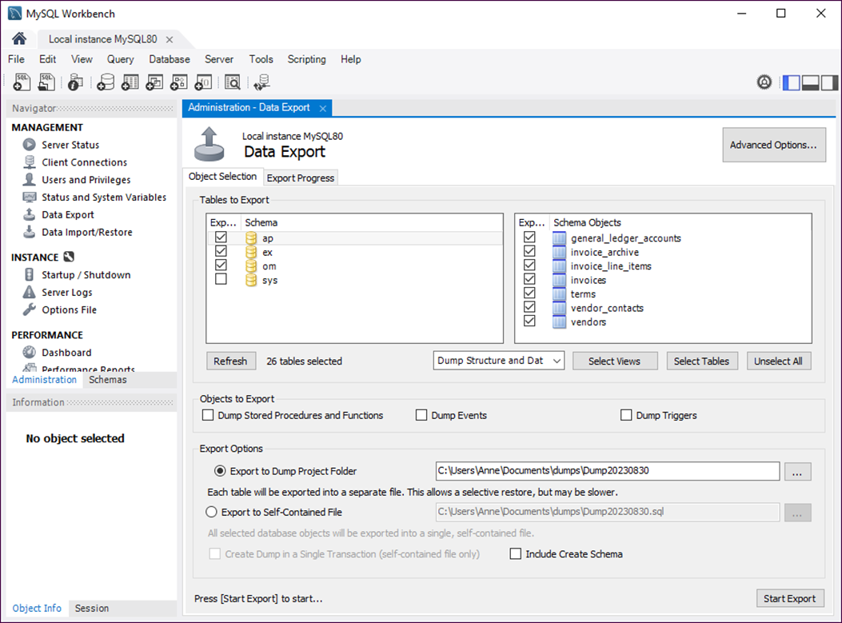
Workbench after selecting the data to back up

Slide 6
How to back up one or more databases
Use Workbench to connect to the local server.
Select Data Export from the Management category of the Administration tab.
Click on any database name to display its objects.
Select the databases and objects you want to back up.
Click the Start Export button.

Slide 7
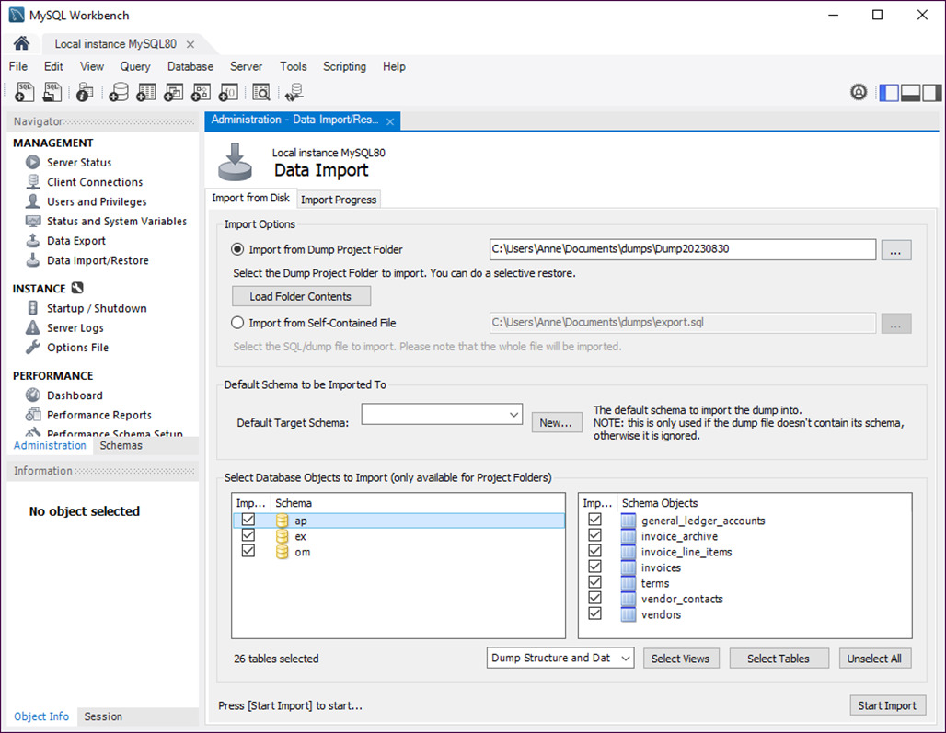
Workbench after selecting the data to restore

Slide 8
How to restore one or more databases from a full backup
Use Workbench to connect to the local server.
Select Data Import/Restore from the Management category of the Administration tab.
Select the folder that contains the backup scripts.
Deselect any databases and objects that you don’t want to restore.
Click the Start Import button.

Slide 9
The files for a binary log named bin-log
bin-log.index
bin-log.000001
bin-log.000002
bin-log.000003
...
How to change to MySQL’s bin directory
Using Windows
cd /program files/mysql/mysql server 8.0/bin
Using macOS or Unix/Linux
cd /usr/local/mysql/bin

Slide 10
How to use mysqlbinlog to execute statements
For all databases
mysqlbinlog /murach/mysql/bin-log.000001 | mysql -u root -p
For a specific database
mysqlbinlog --database=ap /murach/mysql/bin-log.000001 | mysql -u root -p
For a specific time range
mysqlbinlog --start-datetime="2023-01-10 00:00:00"
--end-datetime="2023-01-10 04:30:00" /murach/mysql/bin-log.000001 | mysql -u root -p
For all databases using multiple binary log files
mysqlbinlog /murach/mysql/bin-log.000001
/murach/mysql/bin-log.000002 | mysql -u root -p

Slide 11
How to use mysqlbinlog to execute statements (continued)
For all databases using multiple binary log files (macOS and Unix/Linux only)
mysqlbinlog /murach/mysql/bin-log.[0-9]* | mysql -u root -p
Notes for macOS
You typically need to
Begin by coding the sudo command
Code a dot and slash before the name of the mysqlbinlog program and the mysql program
Specify a path to the data directory
You may find it helpful to specify a password using the --password option.

Slide 12
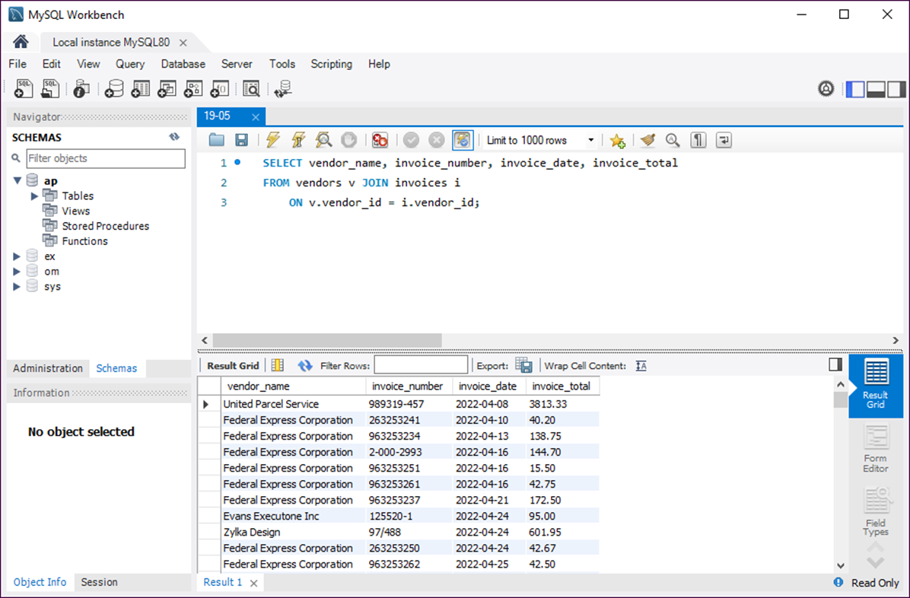
Workbench after selecting the data to export

Slide 13
How to export selected data to a file
Use Workbench to run the statement that selects the data.
Click the Export button that’s displayed above the result set.
Use the Export dialog box to specify a name and type for the file.
A CSV (comma-separated values) file
vendor_name,invoice_number,invoice_date,invoice_total
"United Parcel Service",989319-457,2022-04-08,3813.33
"Federal Express Corporation",263253241,2022-04-10,40.20
"Federal Express Corporation",963253234,2022-04-13,138.75
...

Slide 14
A CSV file that contains vendor contacts
vendor_id,last_name,first_name
19,Strummer,Joe
77,Jones,Mick
85,Simonon,Paul
How to import data from a CSV or JSON file
Use Workbench to run a statement that selects all rows and columns from the destination table.
Click the Import button that’s displayed above the result set.
Use the Import dialog box to select the file that contains the data and click the Next button.
Continue clicking the Next button and setting the options until the import finishes.

Slide 15
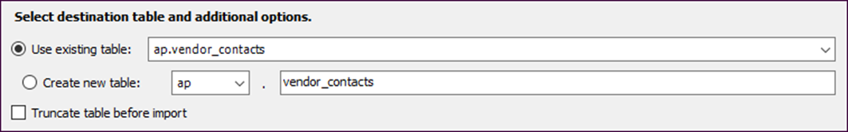
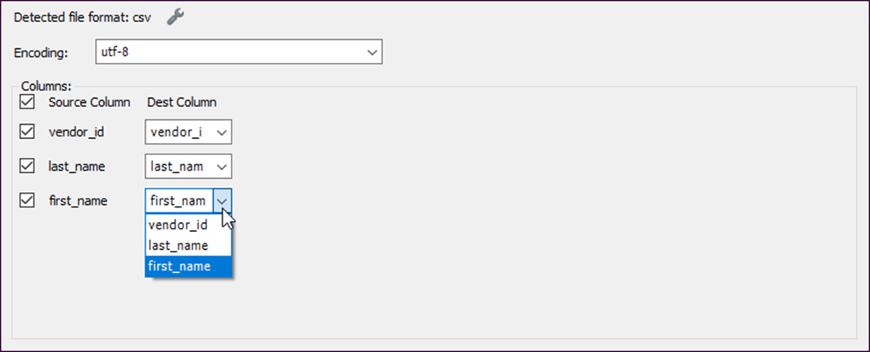
The destination table options
The import options for a CSV file

